Slide 1

50.039 Theory and Practice of Deep Learning W2-S2 Neural Networks, Initializers, Optimizers and other Good Practices
Matthieu De Mari

Slide 2
About this week (Week 2)
What are the typical initializers for trainable parameters in Neural Networks?
What is symmetry in a Neural Network and why is it essential to break it with proper initializers?
What is the exploding gradient problem?
How to spot and fix an exploding gradient problem?
What is the vanishing gradient problem?
How to spot and fix a vanishing gradient problem?
Why are activation functions needed in Neural Networks?
What is the universal approximation theorem?

Slide 3
About this week (Week 2)
What are typical examples of activation functions? Which activations should I be using?
What are typical examples of advanced optimizers? (Adagrad, RMSProp, Adam, etc.).
How to implement said optimizers manually?
What is a stochastic gradient descent and what are its benefits?
How to implement the stochastic gradient descent manually?
What is a mini-batch gradient descent and what are its benefits?
How to implement the mini-batch gradient descent manually?
How to combine all optimizers concepts into a great optimizer?

Slide 4
About this week (Week 2)
What is the no free lunch theorem?
What is the train-test-validation split? Why is it good practice to use an extra validation set?
What is the early stopping of optimizer concept? Why is it good practice to use it?
What are saver and loader functions? Why is it good practice to use them?
What are other common good practices when it comes to Neural Networks?
How to decide on an appropriate number of layers and neurons?

Slide 5
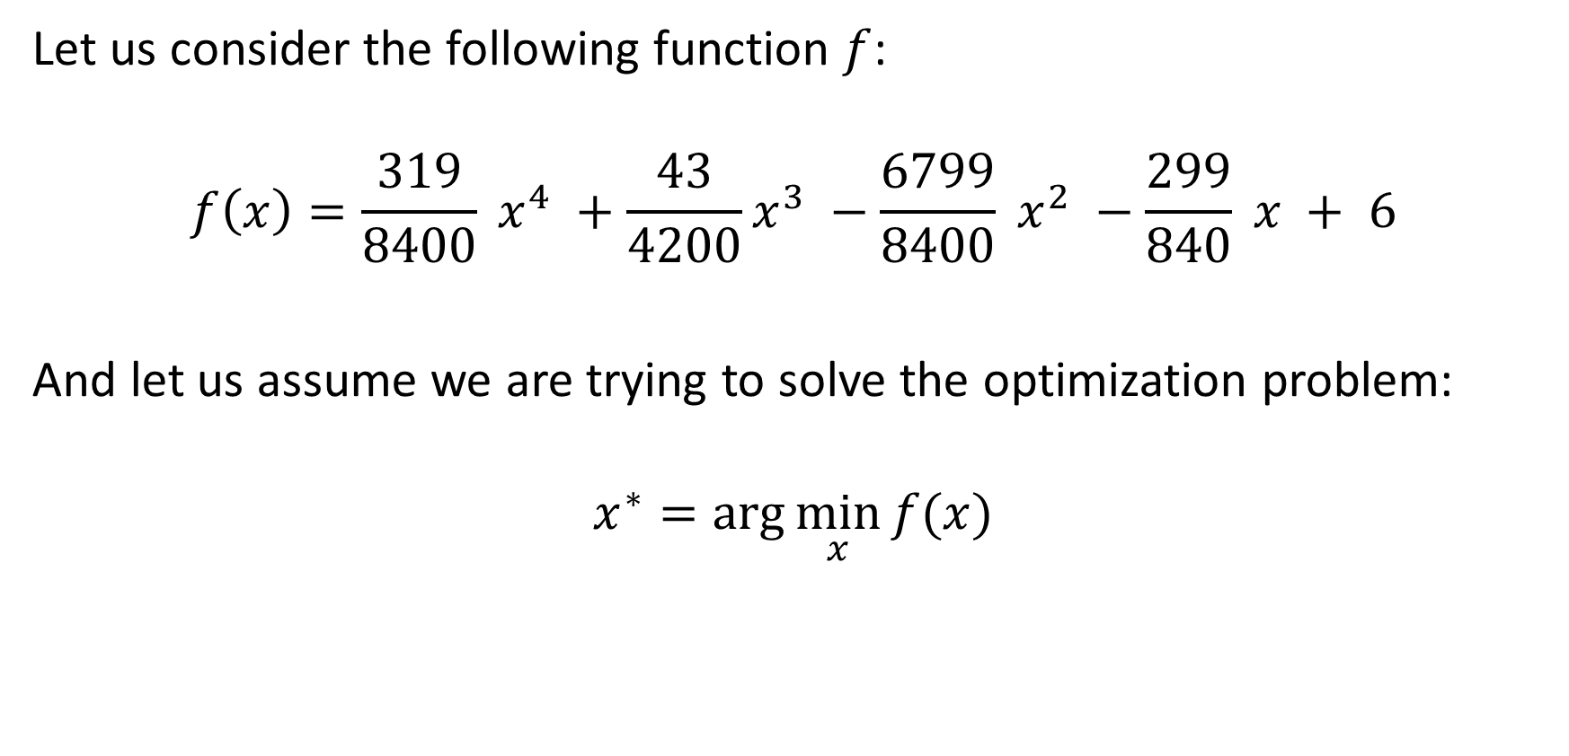
The problem with the GD algorithm
Let us consider the following function $f$:
$$f\left(x\right)=\frac{319}{8400} x^{4} +\frac{43}{4200}x^{3} −\frac{6799}{8400} x^{2} −\frac{299}{840} x + 6$$
And let us assume we are trying to solve the optimization problem:
$$x^{∗}=\arg{\min_{x}{f(x)}}$$

Slide 6
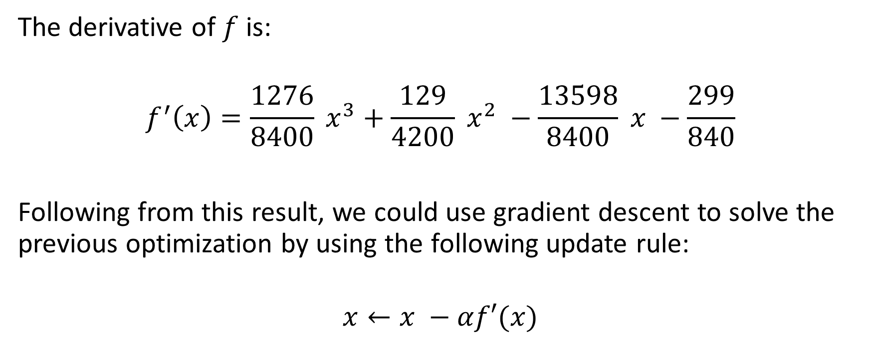
The problem with the GD algorithm
The derivative of $f$ is:
$$f^{′}\left(x\right)=\frac{1276}{8400} x^{3}+\frac{129}{4200} x^{2} −\frac{13598}{8400} x −\frac{299}{840}$$
Following from this result, we could use gradient descent to solve the previous optimization by using the following update rule:
$$x←x −αf′(x)$$

Slide 7
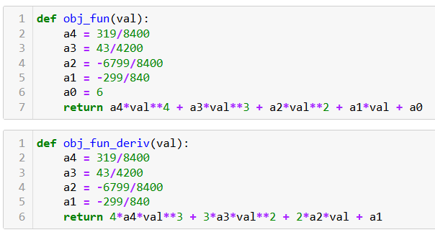
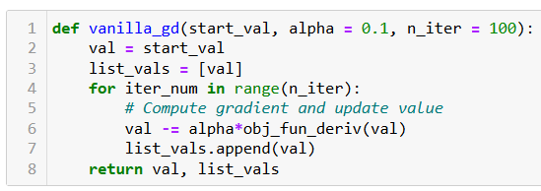

The problem with the GD algorithm
Our vanilla gradient descent algorithm is implemented by manually defining the objective function $f$ and its derivative $f′$.
We can then implement our “vanilla” gradient descent algorithm for this optimization problem as shown below.

Slide 8
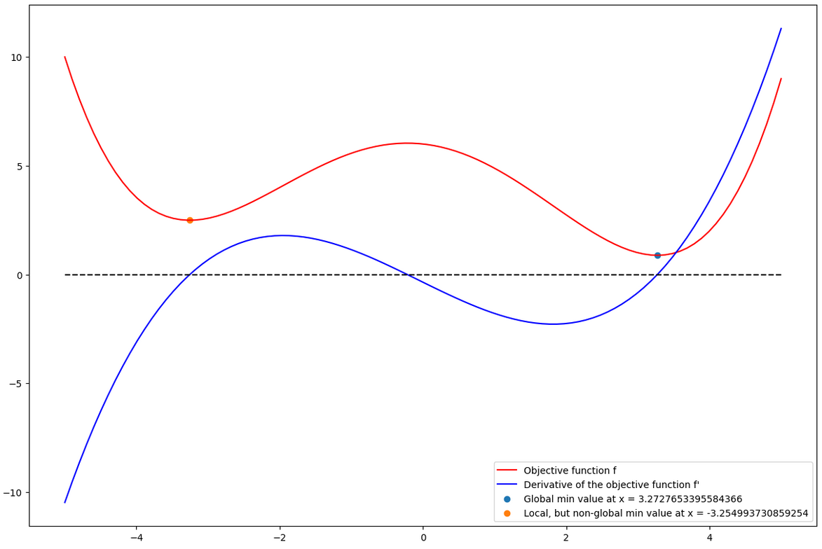

The problem with the GD algorithm
The function $f$ admits a global minimum at $x≈3.27$ and a local (non-global) minimum at $x≈ −3.25$, as shown in the figure below.

Slide 10
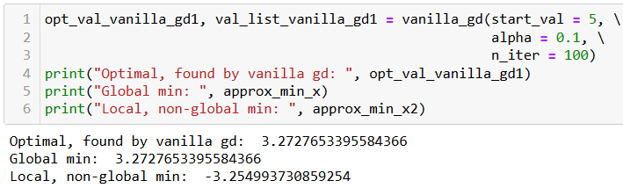

The problem with the GD algorithm
When using $x_{0} = 5$as a starting point for our gradient descent algorithm, we end up converging to the global minimum.
(Success!)

Slide 11
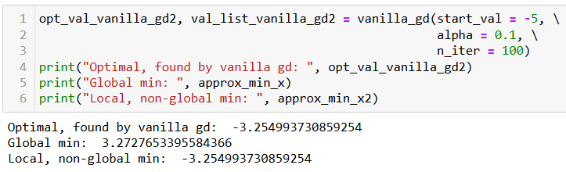

The problem with the GD algorithm
When using $x_{0} =−5$as a starting point for our gradient descent, however, we end up converging to the local (non-global) minimum.
Observation: Unfortunately, in the presence of local non-global minima, the GD algorithm might end up getting trapped and converging to the wrong minimum.

Slide 12
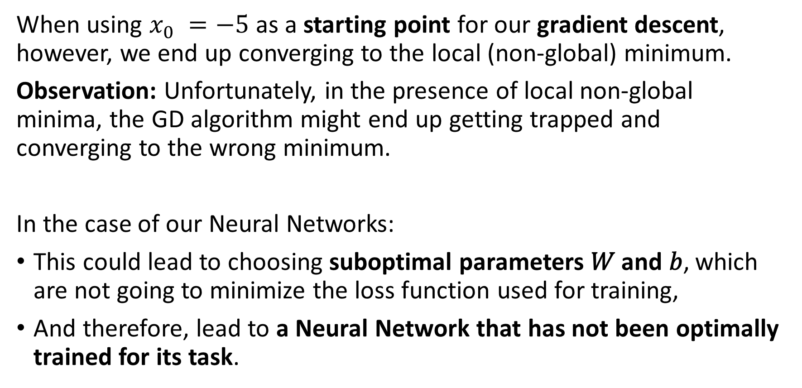
The problem with the GD algorithm
When using $x_{0} =−5$as a starting point for our gradient descent, however, we end up converging to the local (non-global) minimum.
Observation: Unfortunately, in the presence of local non-global minima, the GD algorithm might end up getting trapped and converging to the wrong minimum.
In the case of our Neural Networks:
This could lead to choosing suboptimal parameters 𝑊 and 𝑏, which are not going to minimize the loss function used for training,
And therefore, lead to a Neural Network that has not been optimally trained for its task.

Slide 13
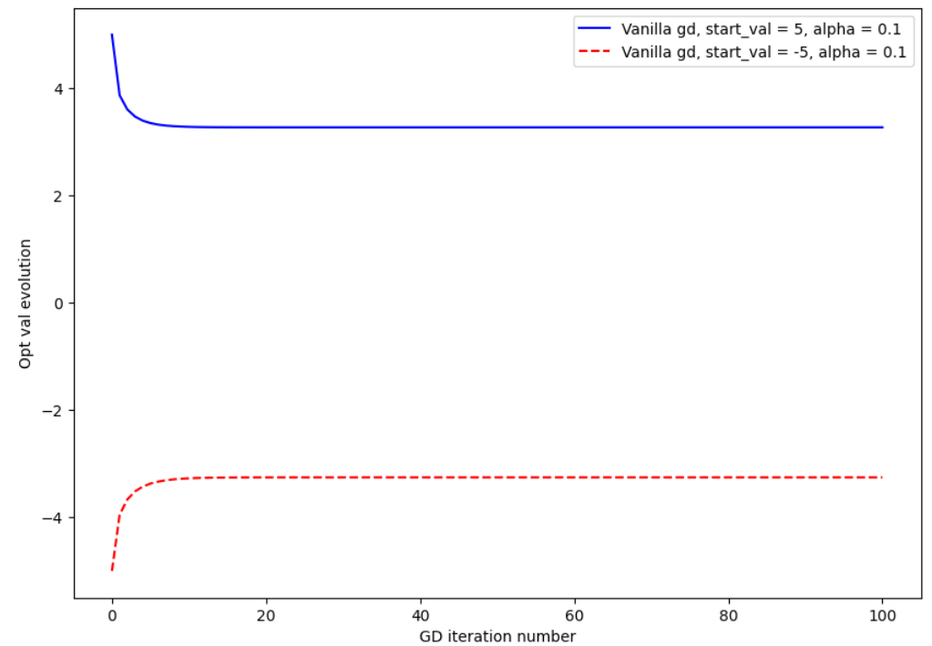
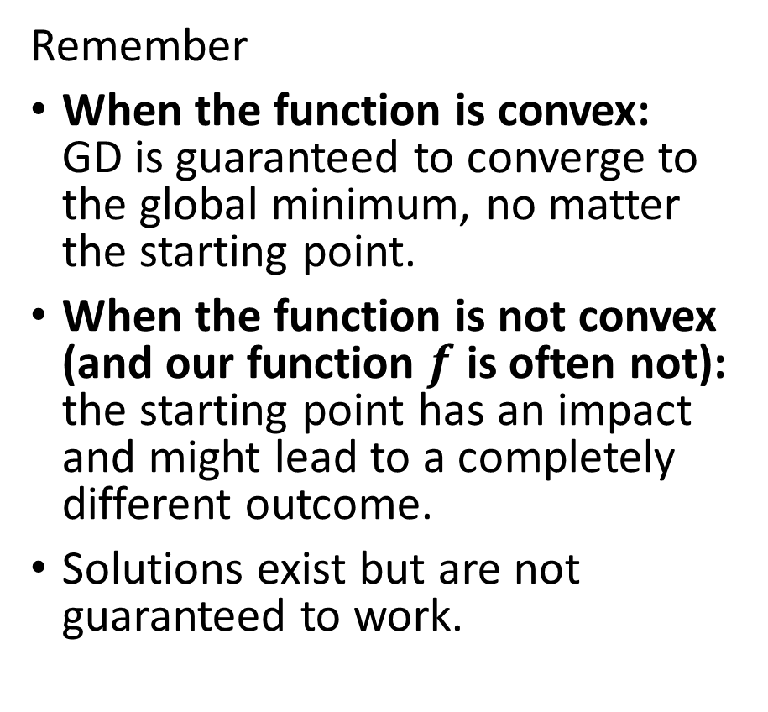
The problem with the GD algorithm
Remember
When the function is convex: GD is guaranteed to converge to the global minimum, no matter the starting point.
When the function is not convex (and our function $f$ is often not): the starting point has an impact and might lead to a completely different outcome.
Solutions exist but are not guaranteed to work.

Slide 14
Adding momentum to gradient descent
Definition (Gradient Descent with Added Momentum):
To alleviate this phenomenon, we propose to use momentum.
It is a method that helps accelerate the training process by updating the weights of the model by reusing values from the past gradients.
The idea is that, if a direction in the parameters space consistently leads to good reduction in the loss function, then that direction should be reinforced.

Slide 15
Adding momentum to gradient descent
Definition (Gradient Descent with Added Momentum):
To alleviate this phenomenon, we propose to use momentum.
It is a method that helps accelerate the training process by updating the weights of the model by reusing values from the past gradients.
The idea is that, if a direction in the parameters space consistently leads to good reduction in the loss function, then that direction should be reinforced.

Slide 16
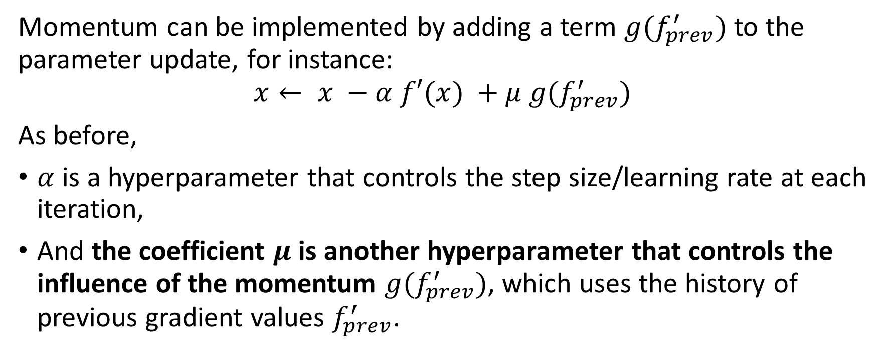
Adding momentum to gradient descent
Momentum can be implemented by adding a term $g(f_{prev}^{′})$ to the parameter update, for instance:
$$x← x −α f′(x) +μ g(f_{prev}^{′})$$
As before,
$α$ is a hyperparameter that controls the step size/learning rate at each iteration,
And the coefficient $μ$is another hyperparameter that controls the influence of the momentum $g(f_{prev}^{′})$, which uses the history of previous gradient values $f_{prev}^{′}$.

Slide 17
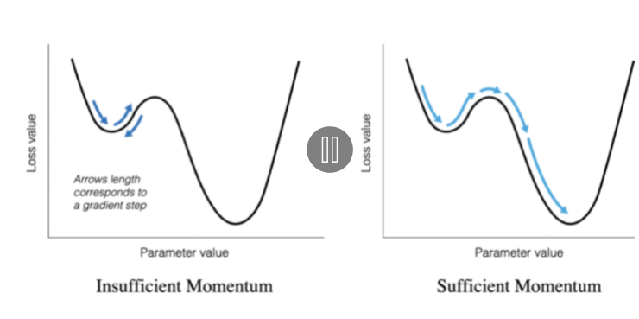
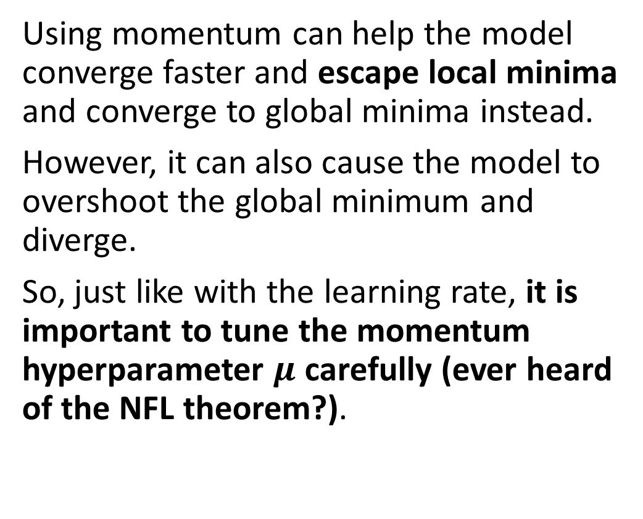
Adding momentum to gradient descent
Using momentum can help the model converge faster and escape local minima and converge to global minima instead.
However, it can also cause the model to overshoot the global minimum and diverge.
So, just like with the learning rate, it is important to tune the momentum hyperparameter $μ$ carefully (ever heard of the NFL theorem?).

Slide 18
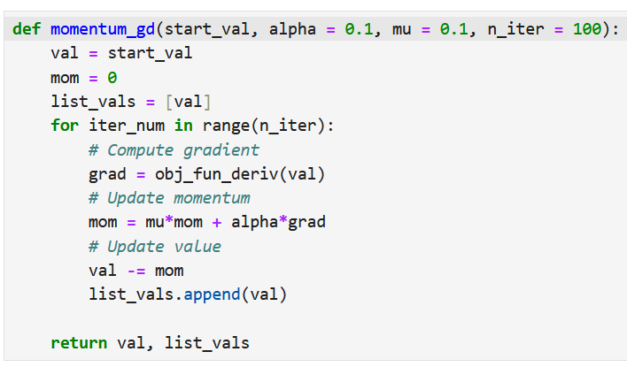
Adding momentum to gradient descent
Definition (Gradient Descent with Added Momentum):
Momentum is a method that helps accelerate the training process by updating the weights of the model by reusing values from the past gradients.
Momentum can be implemented in many ways, by incorporating the previous values of past gradients in some way. We show a possible implementation here.
Another possible implementation (Nesterov Momentum GD) is shown in bonus slides.

Slide 19
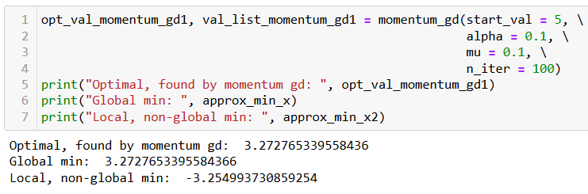
Adding momentum to gradient descent
Case #1 (good scenario): As before, if the starting point is good and not too much momentum is used, we will converge to the correct minimum.

Slide 20
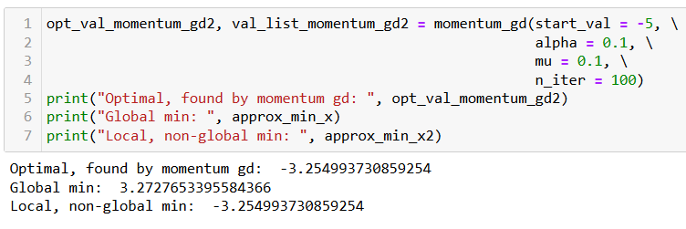
Adding momentum to gradient descent
Case #2 (bad scenario): As before, if the starting point is bad and not too much momentum is used, we will end up converging to the incorrect minimum, like before.

Slide 21
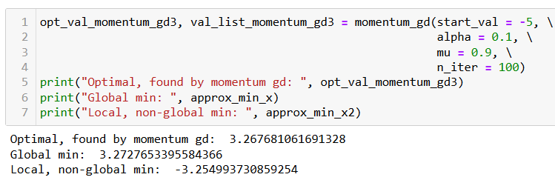
Adding momentum to gradient descent
Case #3 (bad scenario, momentum saves the day): However, if the starting point is bad and enough momentum is used, we might be able to escape the local minimum and converge to the correct minimum.

Slide 22
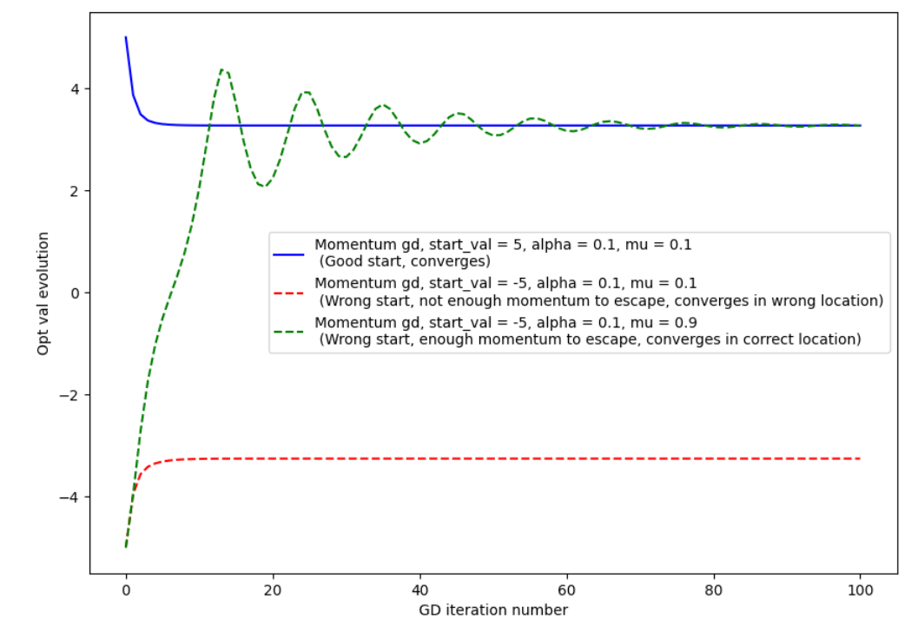
Adding momentum to gradient descent

Slide 23
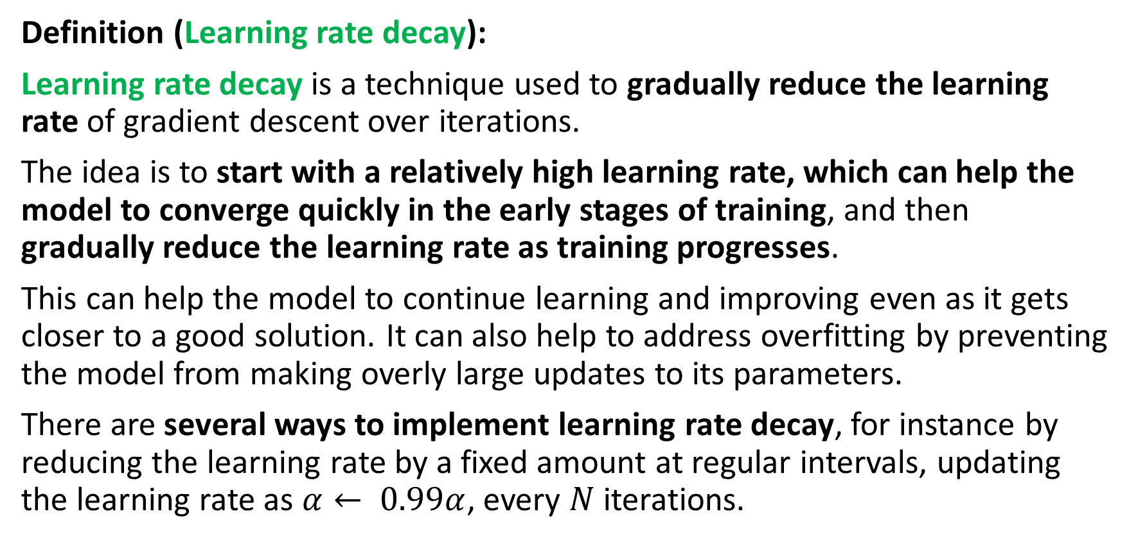
Adding a decay to hyperparameters
Definition (Learning rate decay):
Learning rate decay is a technique used to gradually reduce the learning rate of gradient descent over iterations.
The idea is to start with a relatively high learning rate, which can help the model to converge quickly in the early stages of training, and then gradually reduce the learning rate as training progresses.
This can help the model to continue learning and improving even as it gets closer to a good solution. It can also help to address overfitting by preventing the model from making overly large updates to its parameters.
There are several ways to implement learning rate decay, for instance by reducing the learning rate by a fixed amount at regular intervals, updating the learning rate as $α← 0.99α$, every $N$ iterations.

Slide 24
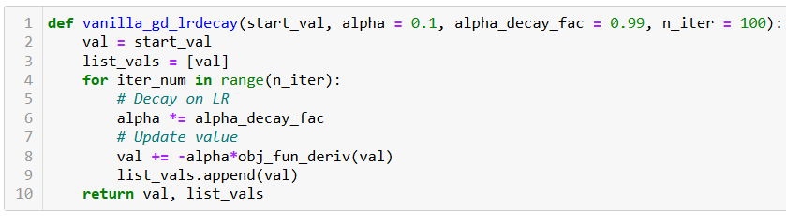

Adding a decay to hyperparameters
A possible implementation of gradient descent with learning rate decay is shown below.
Notice how, on every iteration, the learning rate is updated and decayed as $α←Kα$, with $K$ a decay factor between 0 and 1.

Slide 25
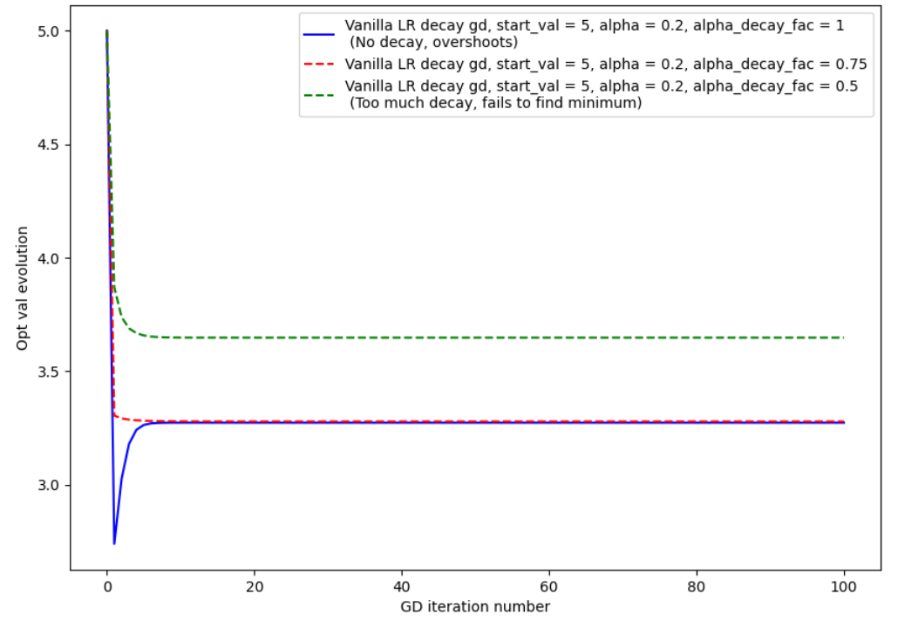
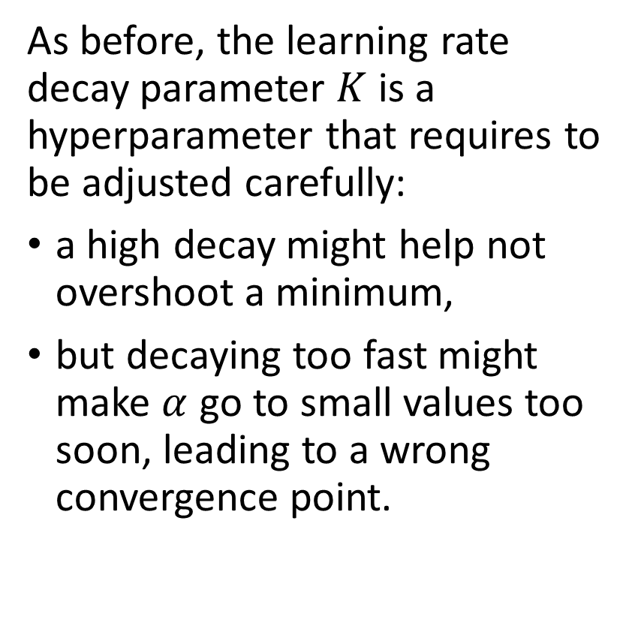
Adding a decay to hyperparameters
As before, the learning rate decay parameter $K$ is a hyperparameter that requires to be adjusted carefully:
a high decay might help not overshoot a minimum,
but decaying too fast might make $α$ go to small values too soon, leading to a wrong convergence point.

Slide 26
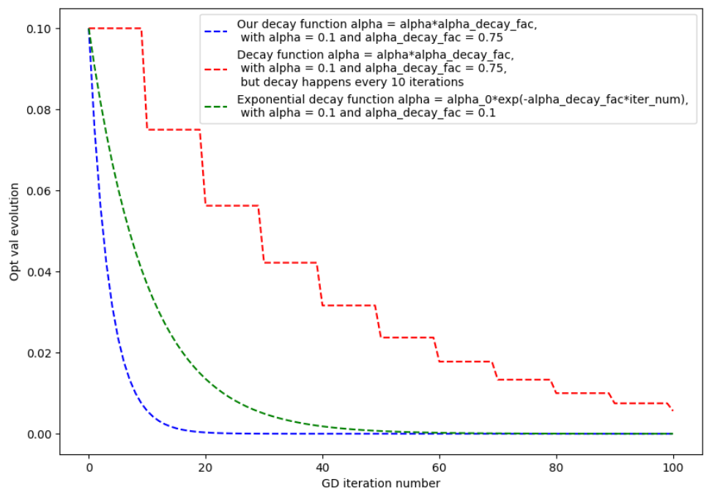
Adding a decay to hyperparameters
Different decay methods can be implemented, with different effects on the gradient descent algorithm: as before (NFL!), worth exploring.

Slide 27
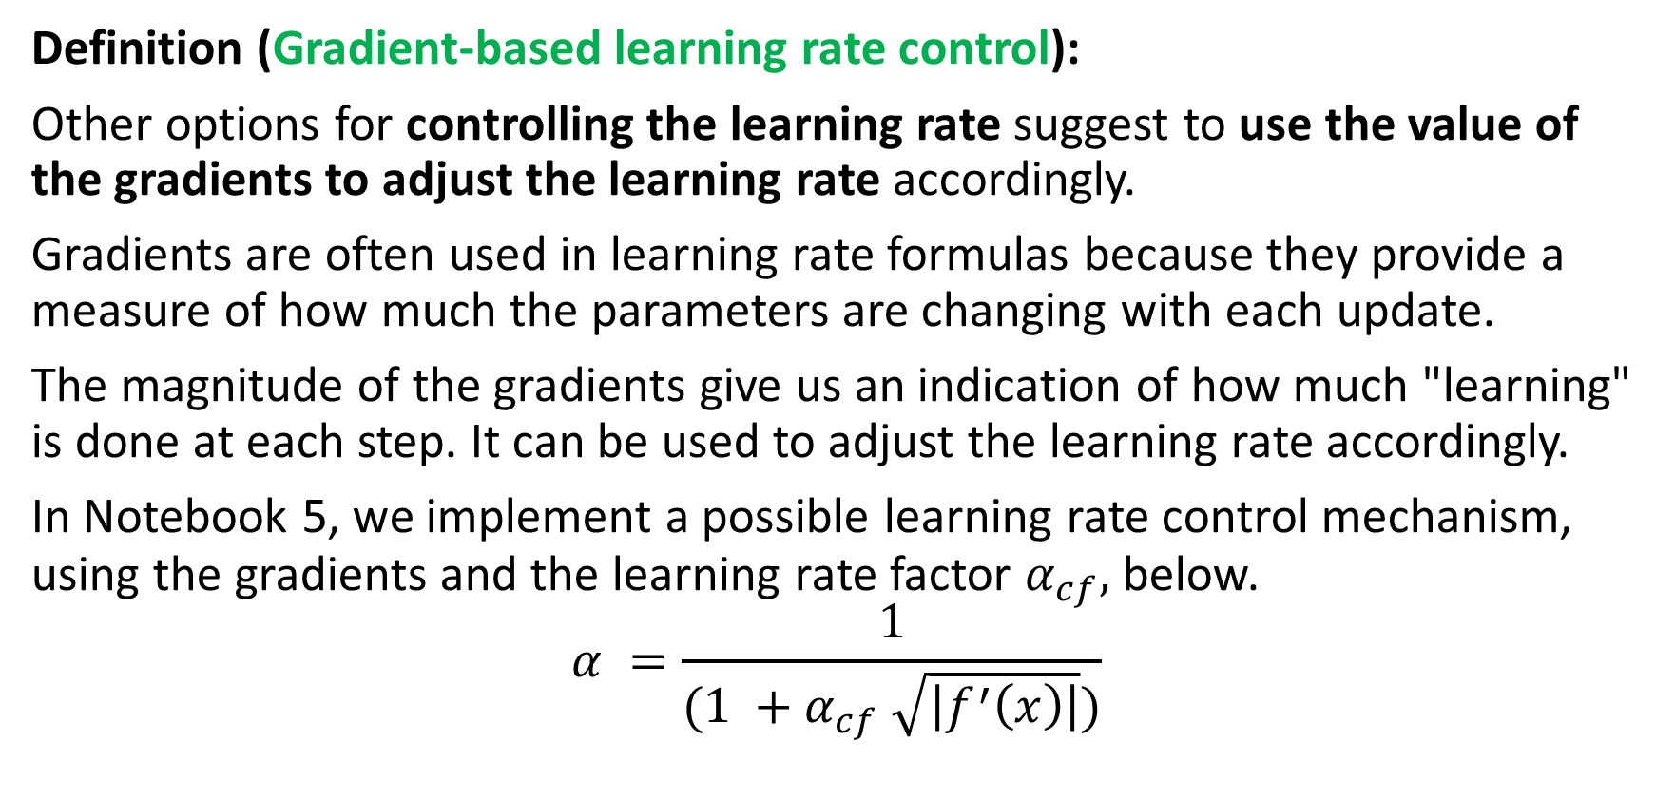
Gradient-based learning rate control
Definition (Gradient-based learning rate control):
Other options for controlling the learning rate suggest to use the value of the gradients to adjust the learning rate accordingly.
Gradients are often used in learning rate formulas because they provide a measure of how much the parameters are changing with each update.
The magnitude of the gradients give us an indication of how much "learning" is done at each step. It can be used to adjust the learning rate accordingly.
In Notebook 5, we implement a possible learning rate control mechanism, using the gradients and the learning rate factor $α_{cf},$below.
$$α =\frac{1}{(1 +α_{cf} \sqrt{\left|f^{′}\left(x\right)\right|})}$$

Slide 28
Idea behind gradient-based LR control
Core idea: Gradient-based learning rate control is typically used to make the learning rate inversely proportional to the mean gradient value (or its mean squared value).
By doing so,
if the gradients are small (i.e. the model is making small updates to its weights), the resulting learning rate will be increased to prevent vanishing gradients.
and if the gradients are large (i.e. the model is making large updates to its weights), the resulting learning rate will be lowered to prevent exploding gradients.

Slide 29
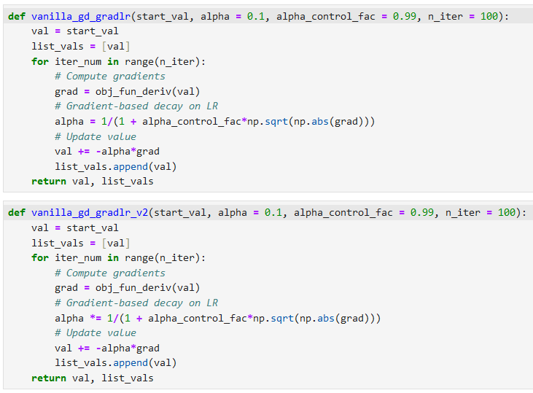

Gradient-based learning rate control
A possible gradient-based learning control scheme:
$$α =\frac{1}{(1 +α_{cf} \sqrt{\left|f^{′}\left(x\right)\right|})}$$

Slide 30
Gradient-based learning rate control
Open question: What would change if I decided to replace the = sign in line 8 with a *= instead, as shown below?

Slide 31
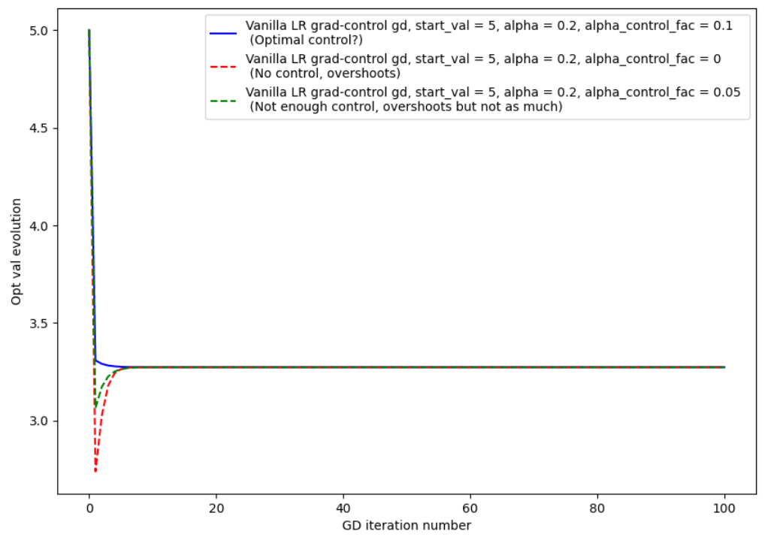
Gradient-based learning rate control

Slide 32
Gradient-based learning rate control
This can also help to prevent the model from making overly large updates, which can – in turn – help to improve generalization by preventing overfitting.
Most advanced gradient descent algorithms will typically combine
A gradient-based learning rate (LR) control,
A learning rate (LR) decay,
And some momentum formula.
Adjustments on the hyperparameters values for each component will be left to the human behind the keyboard!

Slide 33
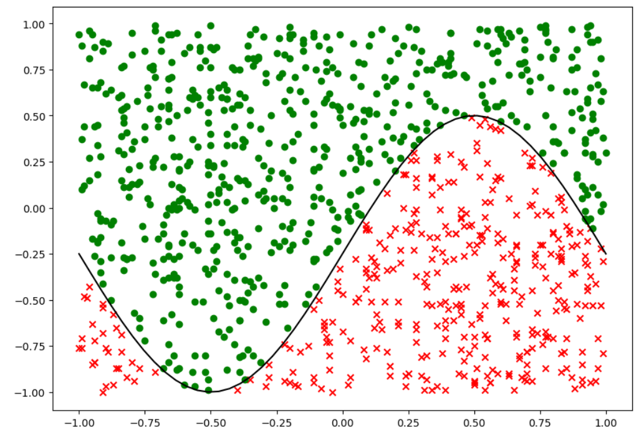
Going back to our classification dataset

Slide 34
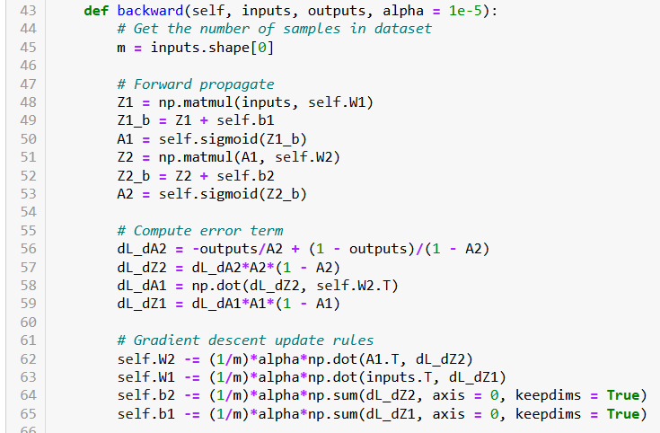
So far, training using “vanilla” gradient descent

Slide 35
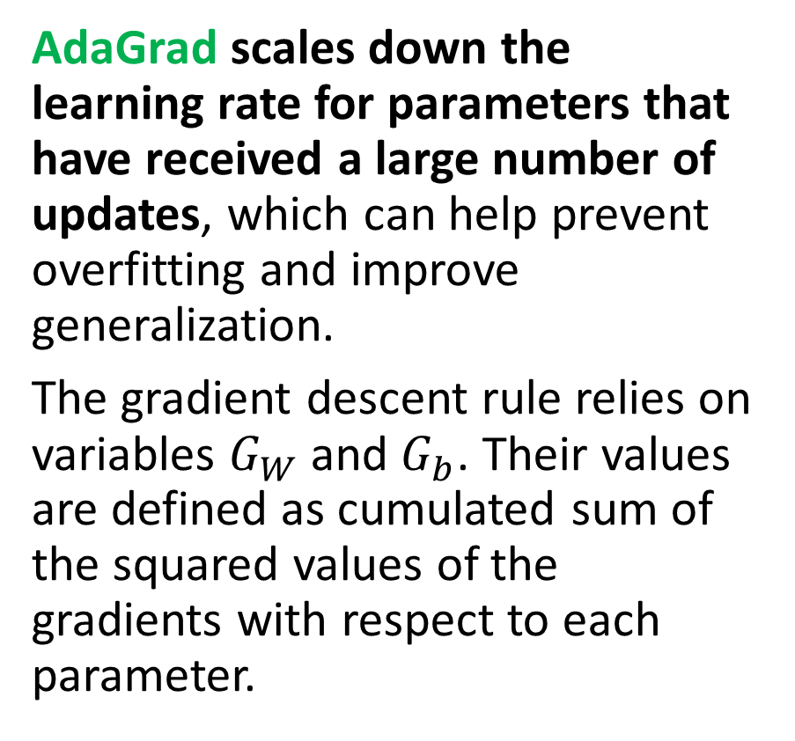
AdaGrad
Definition (AdaGrad optimizer [AdaGrad2011]):
AdaGrad is variation of gradient descent, which adapts the learning rate for each parameter separately, based on the historical gradient information for that parameter.
AdaGrad scales down the learning rate for parameters that have received a large number of updates, which can help prevent overfitting and improve generalization.
The gradient descent rule relies on variables $G_{W}$and $G_{b}$. Their values are defined as cumulated sum of the squared values of the gradients with respect to each parameter.

Slide 36
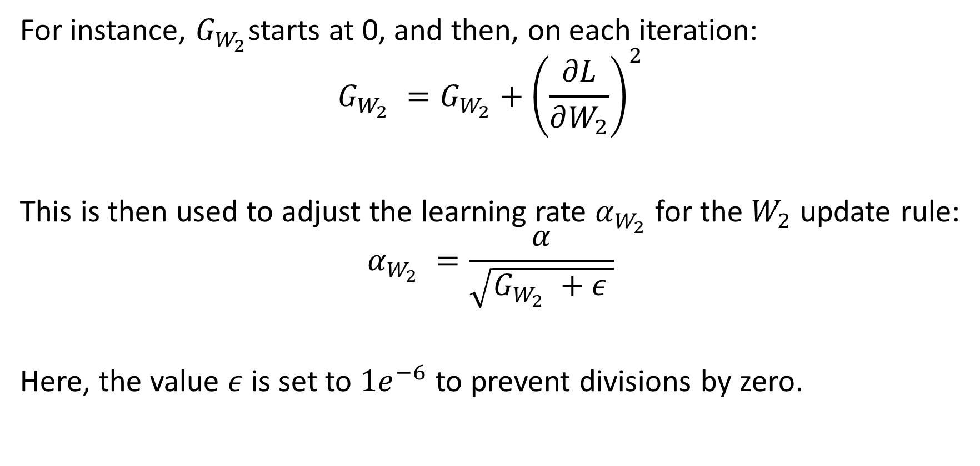
AdaGrad
For instance, $G_{W_{2}}$starts at 0, and then, on each iteration:
$$G_{W_{2}} =G_{W_{2}}+{\left(\frac{∂L}{∂W_{2}}\right)}^{2}$$
This is then used to adjust the learning rate $α_{W_{2}}$for the $W_{2}$ update rule:
$$α_{W_{2}} =\frac{α}{\sqrt{G_{W_{2}} +ε }}$$
Here, the value $ε$is set to $1e^{−6}$ to prevent divisions by zero.

Slide 37
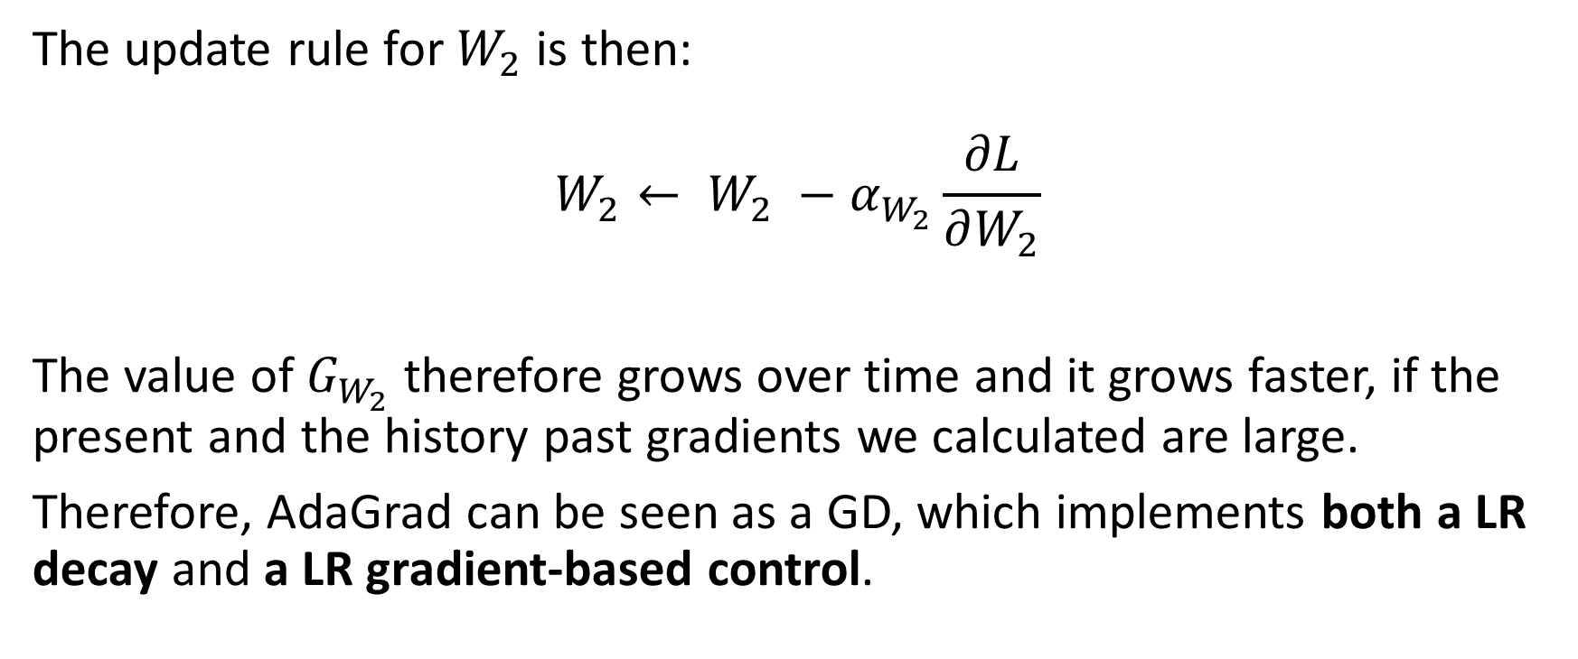
AdaGrad
The update rule for $W_{2}$ is then:
$$W_{2}← W_{2} −α_{W_{2}}\frac{∂L}{∂W_{2}}$$
The value of $G_{W_{2}}$ therefore grows over time and it grows faster, if the present and the history past gradients we calculated are large.
Therefore, AdaGrad can be seen as a GD, which implements both a LR decay and a LR gradient-based control.

Slide 38
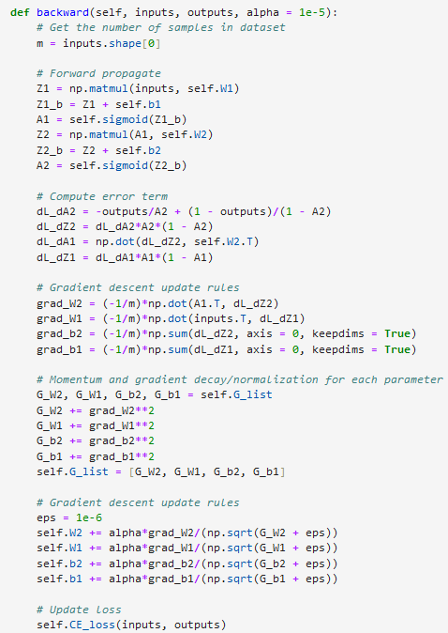
AdaGrad implementation
Keep history of gradient in a list called G_list, which will be updated on each iteration of backward
(Note that it could have also been an attribute for class)
Compute gradients and G_X Coefficients for each trainable parameter X
Update rule uses adjusted learning rate for each parameter and epsilon value.

Slide 39
RMSProp
Definition (RMSProp optimizer [RMSProp2012]):
RMSProp is a variation of AdaGrad, but it uses a running average of the squared gradients to scale the learning rate for each parameter, rather than using the sum of the squared gradients as in AdaGrad.
RMSProp can be less sensitive to the learning rate than AdaGrad, and it is often used in conjunction with other techniques such as momentum.
We will typically keep this idea in mind for later when designing the Adam optimizer.

Slide 40
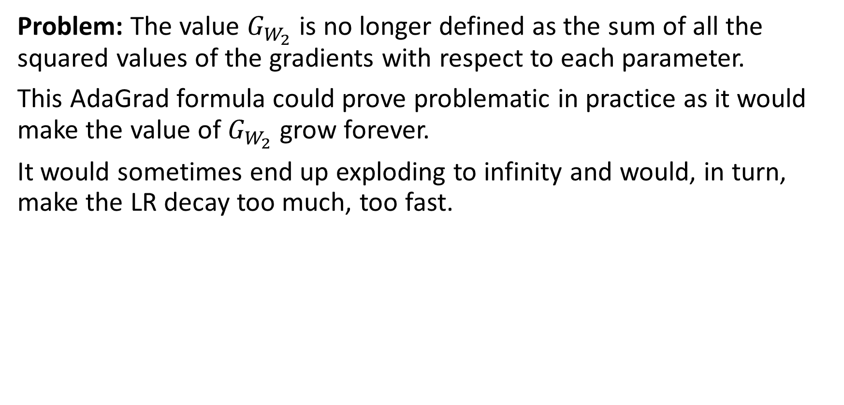
RMSProp
Problem: The value $G_{W_{2}}$ is no longer defined as the sum of all the squared values of the gradients with respect to each parameter.
This AdaGrad formula could prove problematic in practice as it would make the value of $G_{W_{2}}$grow forever.
It would sometimes end up exploding to infinity and would, in turn, make the LR decay too much, too fast.

Slide 41
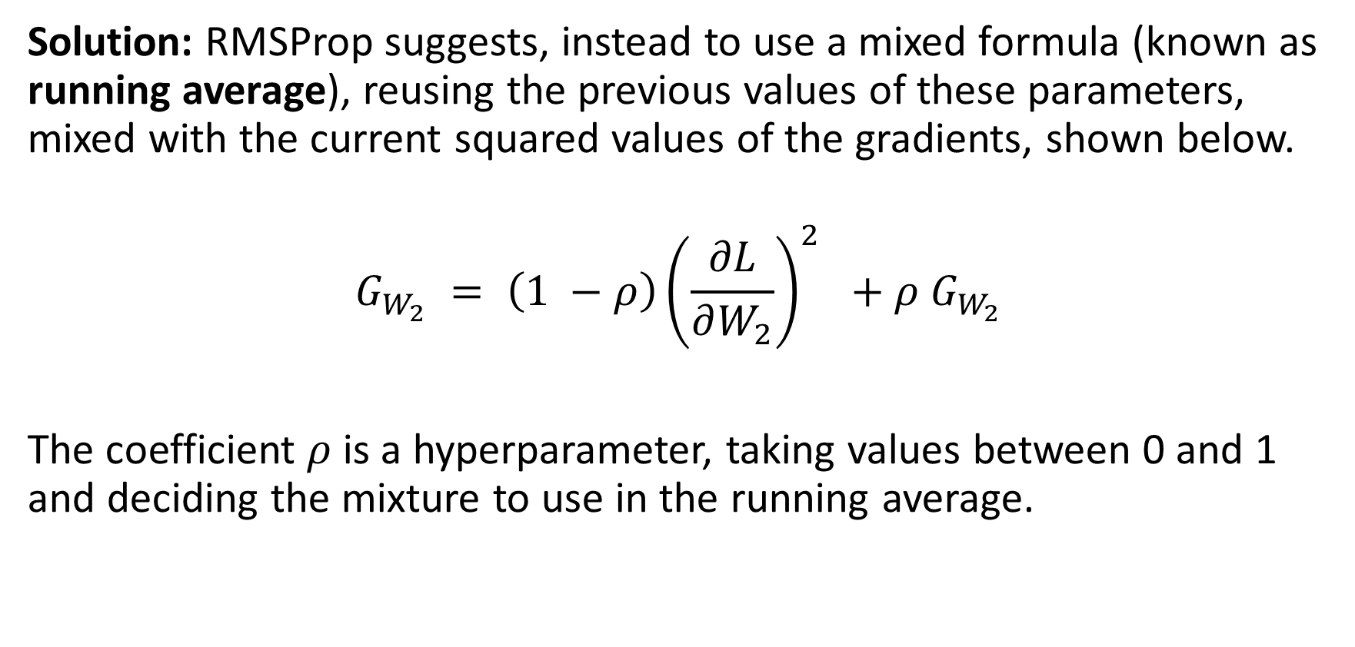
RMSProp
Solution: RMSProp suggests, instead to use a mixed formula (known as running average), reusing the previous values of these parameters, mixed with the current squared values of the gradients, shown below.
$$G_{W_{2}} = \left(1 −ρ\right){\left(\frac{∂L}{∂W_{2}}\right)}^{2} +ρ G_{W_{2}}$$
The coefficient $ρ$ is a hyperparameter, taking values between 0 and 1 and deciding the mixture to use in the running average.

Slide 42
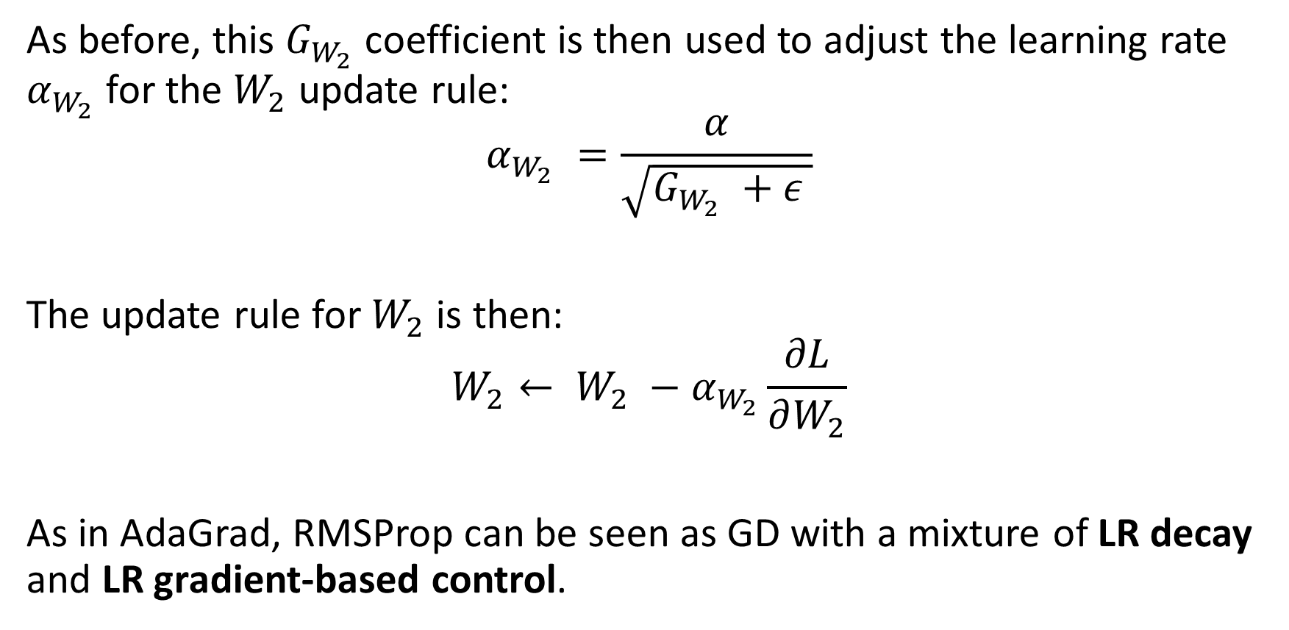
RMSProp
As before, this $G_{W_{2}}$coefficient is then used to adjust the learning rate $α_{W_{2}}$for the $W_{2}$ update rule:
$$α_{W_{2}} =\frac{α}{\sqrt{G_{W_{2}} +ε }}$$
The update rule for $W_{2}$ is then:
$$W_{2}← W_{2} −α_{W_{2}}\frac{∂L}{∂W_{2}}$$
As in AdaGrad, RMSProp can be seen as GD with a mixture of LR decay and LR gradient-based control.

Slide 43
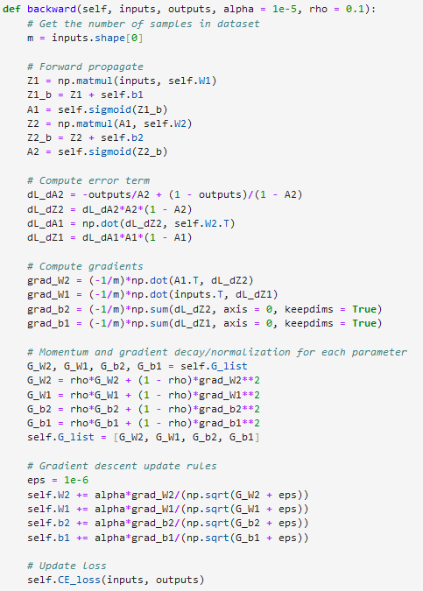
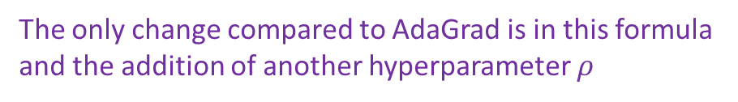
RMSProp implementation
The only change compared to AdaGrad is in this formula and the addition of another hyperparameter $ρ$

Slide 44
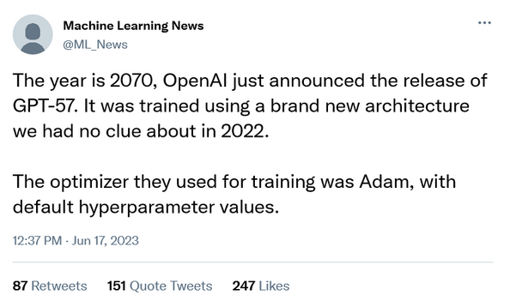
Adam
Definition (Adam optimizer [Adam2015]):
Adam is a very popular variation of gradient descent that combines the ideas of momentum and RMSProp.
Adam is a widely used (possibly the most used?) optimizer, as it can often achieve good performance with relatively little hyperparameter tuning.

Slide 45
Adam
Definition (Adam optimizer [Adam2015]):
Adam is a very popular variation of gradient descent that combines the ideas of momentum and RMSProp.
Adam is a widely used (possibly the most used?) optimizer, as it can often achieve good performance with relatively little hyperparameter tuning.
Adam combines two things:
exponentially decaying averages of the past gradients to scale the learning rate for each parameter,
and exponentially decaying average of the past squared gradients to scale the learning rate for each parameter (as in RMSProp).

Slide 46
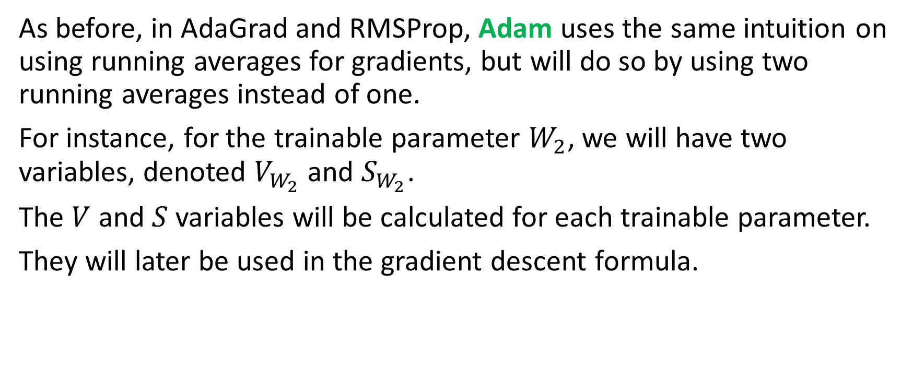
Adam
As before, in AdaGrad and RMSProp, Adam uses the same intuition on using running averages for gradients, but will do so by using two running averages instead of one.
For instance, for the trainable parameter $W_{2}$, we will have two variables, denoted $V_{W_{2}}$and $S_{W_{2}}$.
The $V$ and $S$ variables will be calculated for each trainable parameter.
They will later be used in the gradient descent formula.

Slide 47
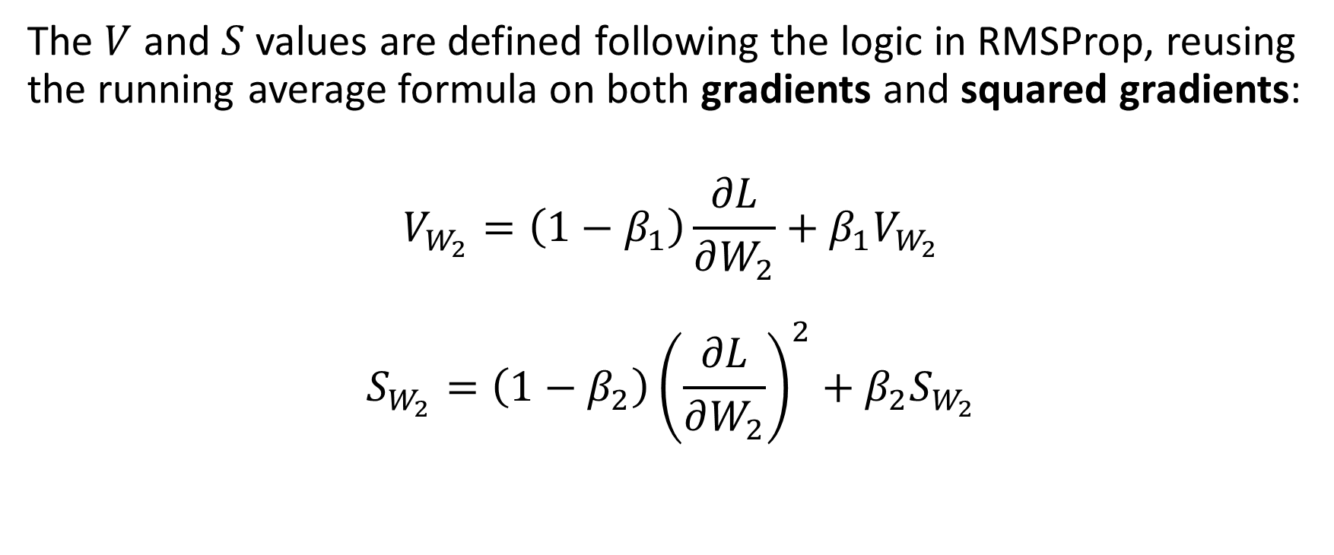
Adam
The $V$ and $S$ values are defined following the logic in RMSProp, reusing the running average formula on both gradients and squared gradients:
$$V_{W_{2}}=\left(1−β_{1}\right)\frac{∂L}{∂W_{2}}+β_{1}V_{W_{2}}$$
$$S_{W_{2}}=\left(1−β_{2}\right){\left(\frac{∂L}{∂W_{2}}\right)}^{2}+β_{2}S_{W_{2}}$$

Slide 48
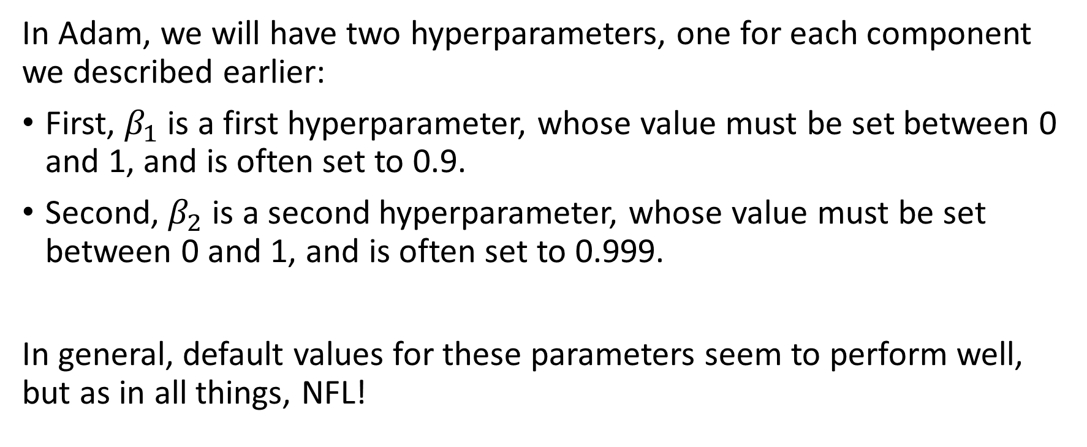
Adam
In Adam, we will have two hyperparameters, one for each component we described earlier:
First, $β_{1}$is a first hyperparameter, whose value must be set between 0 and 1, and is often set to 0.9.
Second, $β_{2}$is a second hyperparameter, whose value must be set between 0 and 1, and is often set to 0.999.
In general, default values for these parameters seem to perform well, but as in all things, NFL!

Slide 49
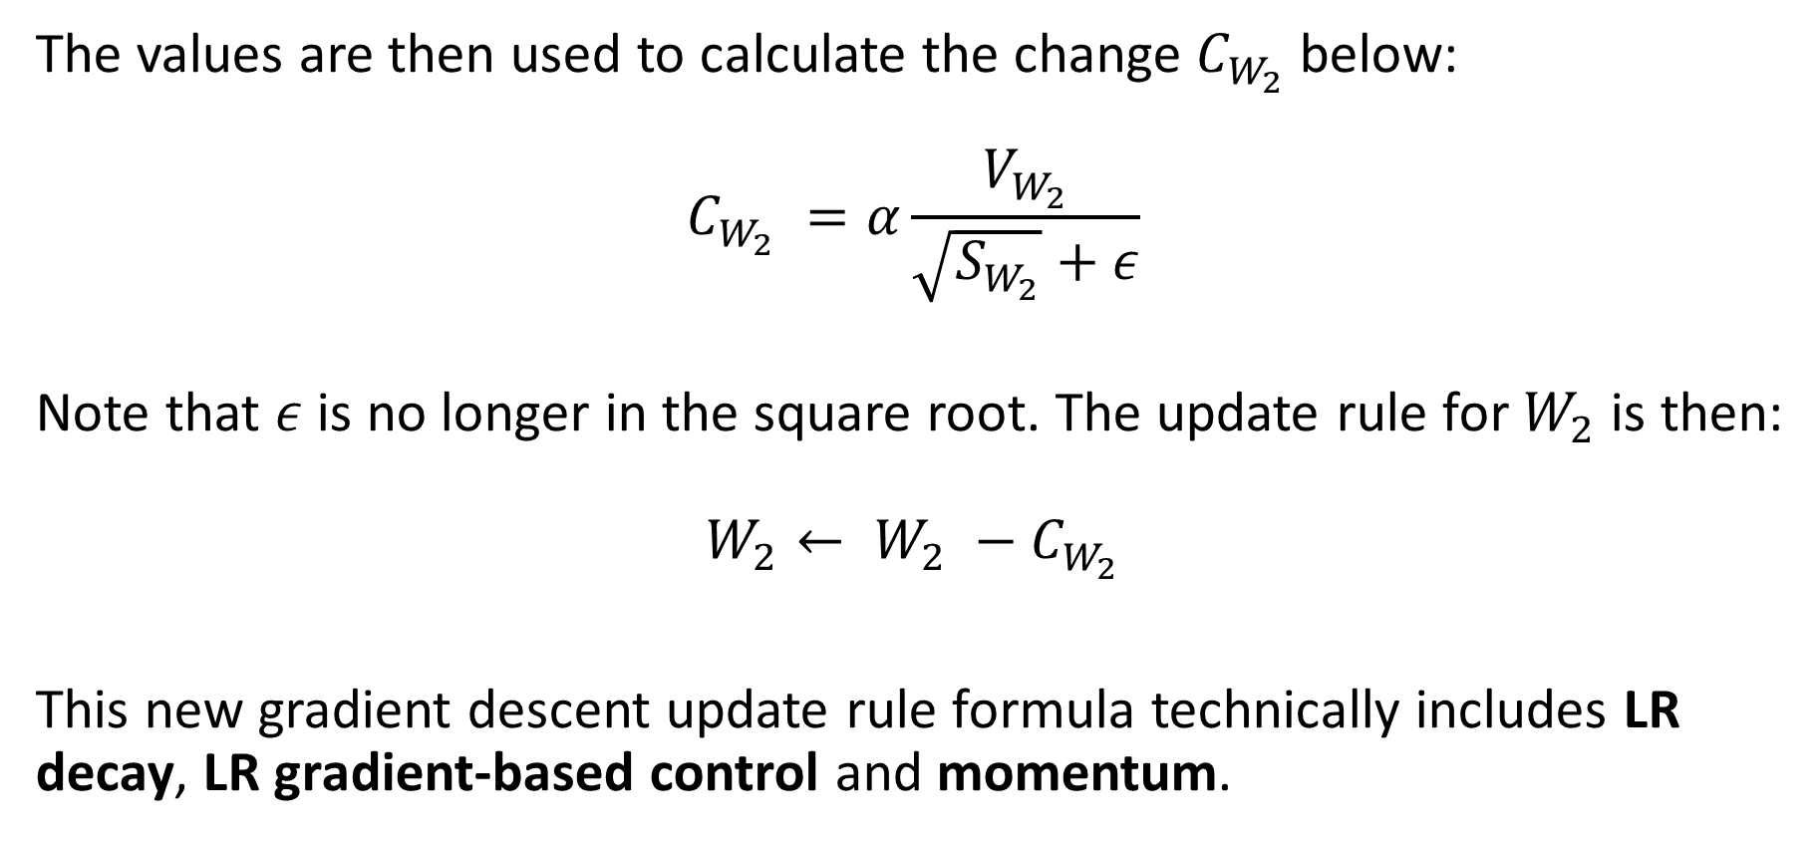
Adam
The values are then used to calculate the change $C_{W_{2}}$below:
$$C_{W_{2}} =α\frac{V_{W_{2}}}{\sqrt{S_{W_{2}}}+ε}$$
Note that $ε$ is no longer in the square root. The update rule for $W_{2}$ is then:
$$W_{2}← W_{2} −C_{W_{2}}$$
This new gradient descent update rule formula technically includes LR decay, LR gradient-based control and momentum.

Slide 50
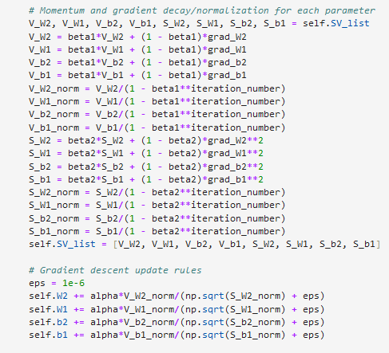
Adam implementation
Compute all eight S and V variables (two for each of the four trainable parameters).
Use update formulas as mentioned.

Slide 51
Adam implementation
Compute all eight S and V variables (two for each of the four trainable parameters).
Use update formulas as mentioned.
We have also implemented an optional normalization of the S and V coefficients.
This is mentioned in the Adam paper, and it typically allows to include the iteration number (which adds learning rate decay over iterarions!).
It could be freely omitted but shown for curiosity.

Slide 52
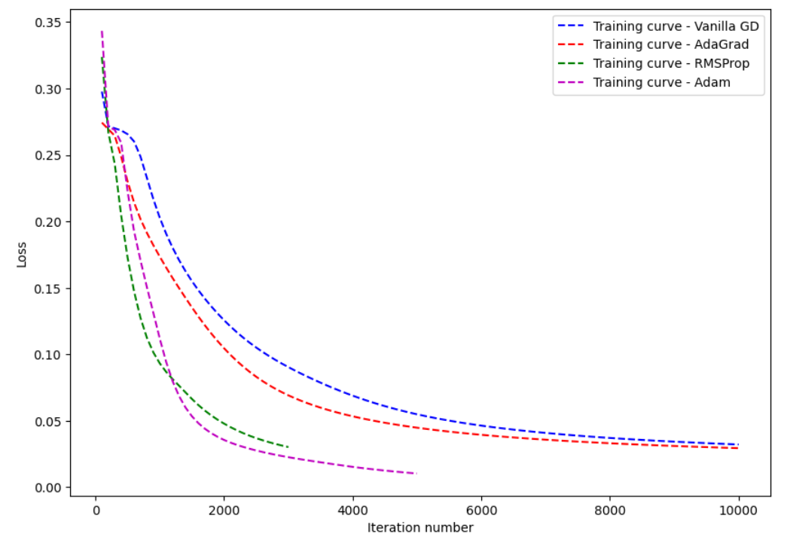
Comparing all four optimizers

Slide 53

Comparing all four optimizers

Slide 54

PyTorch has many more optimizers
These days, most Neural Networks seem to rely on Adam.
As with activation functions, there are a few more (niche) optimizers, implemented in PyTorch.
Worth looking into: https://pytorch.org/docs/stable/optim.html#torch.optim.Optimizer
(Quick discussion, in bonus slides)

Slide 55

Just a question
We have a dataset of $N$ samples, used for training. Our training procedure, so far consists of:
Formulating predictions for all $N$ samples in the dataset, using current model parameters,
Using all $N$ predictions to compute the value of the loss function $L$ for current model parameters, essentially averaging errors over all predictions made on all samples,
Backpropagation using the loss function we just calculated, using parameters update rules calculations and parameters adjustment.

Slide 56

Just a question
On each call of the backward() method, we would therefore perform 1 parameter update using all $N$ samples in the dataset.
This is called a (Full) Batch Gradient Descent.
While this is a slow and safe way to go, do we really need to use all $N$ samples in the dataset to perform one update of the parameters?
Or could we perform more regular updates to reduce the computational cost for each parameter update?

Slide 57



Stochastic Gradient Descent
Definition (Stochastic Gradient Descent [StoGD1951]):
Vanilla Gradient Descent would perform 1 parameter update using all $N$ samples in the dataset.
If we wanted to design the most frequent update scheme, it would probably consist of using of
Formulating predictions for a single sample, randomly drawn in dataset, using current model parameters,
Using this single prediction to compute the value of the loss function $L$ for current model parameters,
Backpropagation using the loss function we just calculated (parameters update rules calculations and parameters adjustment).
This procedure is called Stochastic Gradient Descent.
Stochastic GD: One update per sample?!
1 update using all $N$ samples in dataset

Slide 58

Stochastic Gradient Descent implementation
Implementing the Stochastic Gradient Descent requires to slightly change the trainer method of our class. It will now draw a random sample in the dataset and use this single sample to perform the backward operations.

Slide 59

Stochastic Gradient Descent implementation
In general, slightly faster training, but a lot more erratic.

Slide 60
Stochastic Gradient Descent implementation
In general, slightly faster training, but a lot more erratic.
Reason: Most loss function are using mean/averaging error values over several samples, e.g. Mean Square Error.
Using only one sample in the MSE formula will not lead to a good estimation of the Mean Square Error of the model on the dataset.
Using all samples however leads to the best possible estimations but it is slow to compute.
Stochastic GD: worst estimation of the MSE, but fast to compute
What does the optimal middle ground consist of?
Batch GD: best estimation of MSE loss, but slow to compute.

Slide 61

Intuition behind Mini-ba tch Stochastic GD
What if we used a subset of $N^{′} (with N^{′}<N)$ randomly drawn samples from the dataset to perform one iteration of parameter update instead of
The entire dataset as in (Full) Batch GD,
Or only one sample as in Stochastic GD?
Definition (samples mini-batch):
We call a samples mini-batch, or simply mini-batch, a subset of $N^{′}(with N^{′}<N)$ randomly drawn samples from the dataset.

Slide 62


Stochastic Mini-Batch Gradient Descent
Definition (mini-batch stochastic gradient descent [MiniGD1952]):
The mini-batch stochastic gradient descent uses the following steps:
Formulate predictions for a single mini-batch of $N’$samples, randomly drawn in dataset, using current model parameters,
Using these $N^{′}$predictions to compute the value of the loss function $L$ for current model parameters,
Backpropagation using the loss function we just calculated.
It is therefore our middle ground.
Stochastic GD: worst estimation of the MSE, but fast to compute
What does the optimal middle ground consist of?
→ Mini-batch stochastic GD!
Batch GD: best estimation of MSE loss, but slow to compute.

Slide 63


Mini-batch Stochastic GD implementation
Our trainer will now draw $N’$ random sample in the dataset and use these to perform the backward operations.

Slide 64

Mini-batch Stochastic GD implementation
In general, good performance, might be erratic towards late iterations, but – in general – not as much as stochastic GD.

Slide 65

A quick note on batch sizes
A few remarks regarding batch sizes:
It is often a good idea to choose a batch size $N′$, defined as a power of 2, between 64 and 1024, that is $N′=\{64, 128, 256, 512, 1024\}$.
In general, a larger batch size means slower computation but better training performance.
As in all things so far, it will be about finding the correct balance!
Stochastic GD: worst estimation of the MSE, but fast to compute
What does the optimal middle ground consists of?
→ Mini-batch stochastic GD!
Batch GD: best estimation of MSE loss, but slow to compute.

Slide 66


Mini-batch Stochastic GD implementation

Slide 67

Mini-batch Stochastic GD implementation

Slide 68
Combining everything into a great optimizer
From now on, we will be:
Using an advanced optimizer (like Adam), implementing momentum and gradient-based learning rate control,
Using a mini-batch stochastic gradient descent procedure, drawing mini-batches to perform trainable parameter updates instead of using the entire dataset for each update,
Trying some values for the different hyperparameters (learning rate, batch size, momentum/optimizers parameters, number of iterations, etc.). Often a good idea to start with recommended values and explore from there!

Slide 69
Combining everything into a great optimizer
In an upcoming lesson, we will implement more controls on the learning rate and gradient descent algorithm, for instance:
Learning rate decay: decrease the value of learning rate over iterations like before. (Feel free to try implementing it for practice?)
Early stopping: stop iterations of GD, if network has already achieved a good performance (Done a few times, more in next lecture).
Gradient clipping: prevent gradient values from going above a certain threshold to avoid large modifications on a single iteration (Mentioned in previous lecture, will be implemented on W10 for other purposes).
Etc.

Slide 70
Learn more about these topics
Out of class, supporting papers, for those of you who are curious.
[AdaGrad2011] J. Duchi, E. Hazan, and Y. Singer, “Adaptive Subgradient Methods for Online Learning and Stochastic Optimization”, 2011.
[RMSProp2012] G. Hinton “Neural Networks for Machine Learning”, 2012.
[Adam2015] D. Kingma and J. Ba “Adam: A Method for Stochastic Optimization”, 2015

Slide 71
Learn more about these topics
Out of class, supporting papers, for those of you who are curious.
[StoGD1951] H. Robbins and S. Monro, “A Stochastic Approximation Method”, 1951.
[MiniGD1952] Kiefer and Wolfowitz, “On the Use of Stochastic Approximation Methods in Optimization and Control Problems”, 1952.
Leon Bottou, Yoshua Bengio and Yann LeCun have also worked on implementations of the Mini-batch stochastic Gradient Descent for Neural Networks. https://machinelearningmastery.com/gentle-introduction-mini-batch-gradient-descent-configure-batch-size/

Slide 72
Learn more about these topics
Tracking important names (Track their works and follow them on Scholar, Twitter, or whatever works for you!)
Elad Hazan: Professor at Princeton University, Director and co-founder of Google AI Princeton. https://www.ehazan.com https://scholar.google.com/citations?user=LnhCGNMAAAAJ&hl=fr
Diederik P. Kingma: Research Scientist at Google Brain. http://dpkingma.com/ https://scholar.google.nl/citations?user=yyIoQu4AAAAJ&hl=en
Jimmy Ba: Assistant Professor at University of Toronto. https://jimmylba.github.io/ https://scholar.google.ca/citations?user=ymzxRhAAAAAJ&hl=en

Slide 73
Learn more about these topics
Some extra (easy) reading and videos for those of you who are curious.
[Analy_Vidhya_Optim] Learn more about optimizers. https://www.analyticsvidhya.com/blog/2021/10/a-comprehensive-guide-on-deep-learning-optimizers/
[MLM_GD] Learn more about stochastic mini-batch gradient descent. https://machinelearningmastery.com/gentle-introduction-mini-batch-gradient-descent-configure-batch-size/
Is gradient descent the only way to train parameters anyway? An introduction to the new 2022 training algorithm, from Hinton, called the forward-forward method. https://bdtechtalks.com/2022/12/19/forward-forward-algorithm-geoffrey-hinton/

Slide 74
Other forms of GD with momentum exist
Definition (Gradient Descent with Nesterov Momentum):
Nesterov accelerated gradient descent (NAG) is a variant of momentum gradient descent that can help accelerate convergence and improve the optimization of deep learning models.
It does this by incorporating the concept of momentum, although in a slightly different way than before.
This could help the optimization algorithm to continue moving in the same direction even if the gradients change, but with less oscillations than observed with the previous momentum.
In my opinion, this is neither better or worse, than the previous formula, just different (have I mentioned the NFL theorem yet?).

Slide 75

Other forms of GD with momentum exist
Definition (Gradient Descent with Nesterov Momentum):
Nesterov accelerated gradient descent (NAG) is a variant of momentum gradient descent that can help accelerate convergence and improve the optimization of deep learning models.

Slide 76

Comparing both momentum GD
Gradient Descent with Added Momentum
Nesterov accelerated gradient descent (NAG)

Slide 77
PyTorch has many more optimizers
These days, most Neural Networks seem to rely on Adam.
As with activation functions, there are a few more (niche) optimizers, implemented in PyTorch.
Worth looking into: https://pytorch.org/docs/stable/optim.html#torch.optim.Optimizer
(Quick discussion, in bonus slides)

Slide 78
PyTorch has many more optimizers
There are several recent optimizers that are worth looking into beyond Adam, typically AdaBound , AMSGrad, and Lookahead.
AdaBound is an improved version of Adam that combines the advantages of Adam and the AdaGrad algorithm.
AMSGrad, which stands for Adaptive Moment Estimation with Simulated Annealing and Gradient Descent, is an improved version of Adam that utilizes a special bounding mechanism to prevent overshooting and divergence.
Finally, Lookahead is an algorithm that combines the advantages of several optimization techniques, such as Adam and momentum, to speed up the optimization process.
These are out of scope, but worth mentioning for the curious reader.

